Slide 1
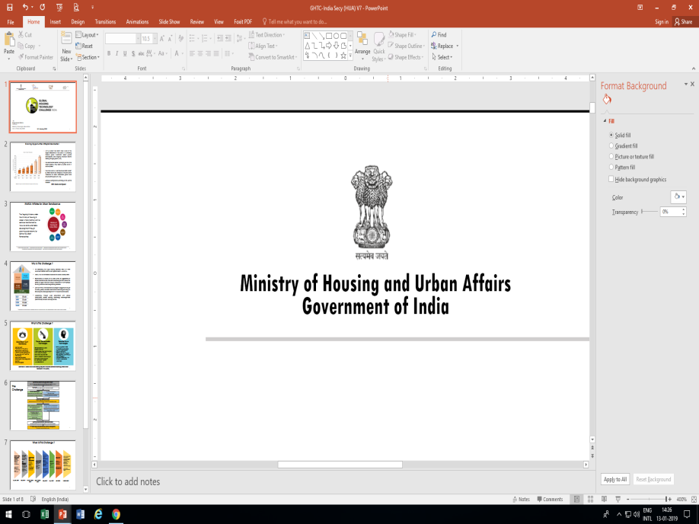
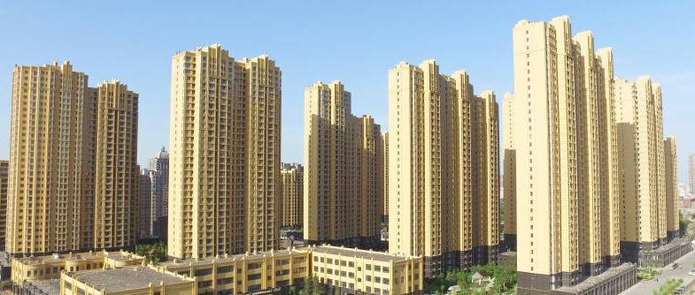


Housing Division
14th July 2021

Slide 2
Key Activities: Housing Division
Legislations-
* Real Estate (Regulation & Development) Act, [RERA]
* Model Tenancy Act [MTA]
Administration of Public Sector Undertakings-
Housing and Urban Development Corporation (HUDCO)
Administration of Autonomous bodies:
Hindustan Prefab Limited (HPL),
Central Government Employees Welfare Housing Organization (CGEWHO),
National Cooperative Housing Federation of India (NCHF)
International Relations-
UN HABITAT,
Asia Pacific Ministerial Conference on Housing and Urban Development (APMCHUD)

Slide 3

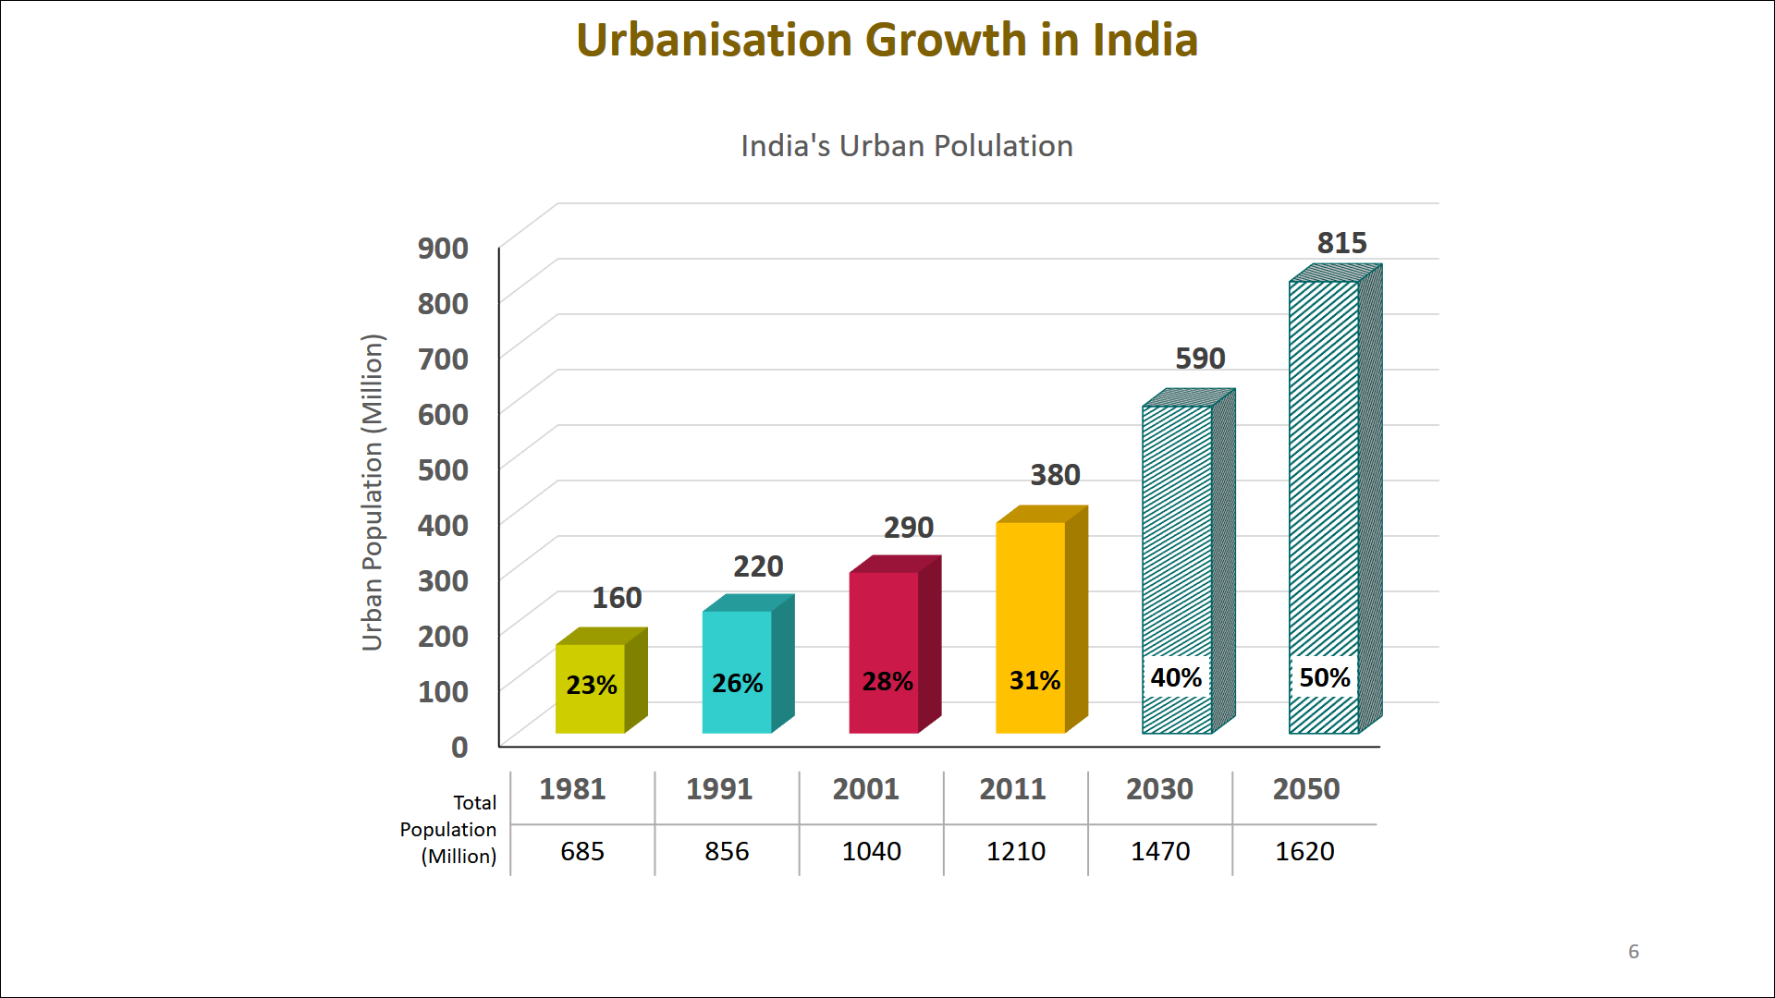
Rapid Urbanization…
India urbanizing rapidly:
  2011- 31% (37 Cr.)
  2050- >50% (81 Cr.)
Real Estate market:
  2017: US $ 120 billion
  2030: ~ US $1 trillion
Contribution to GDP
  2019: 7%
  2025: ~ 13%
Real Estate employment:
  2013: > 4 Cr.
  2020: ~ 5.5 Cr.
Source: UN report on World Urbanisation Prospects (2018)
Notes:
NOTES:
Urban Population Growth is as per UN report on World Urbanisation Prospects (2018)
Real Estate market size and contribution to GDP as per India Brand Equity Foundation (IBEF) report, March 2019:
US $ 120 Billion = 9.12 Lakh Cr (considering $ 1 US = 76 INR)
US $ 1 trillion = 76 Lakh Cr
Employment in Real Estate sector as per India Economic Survey 2018
As per Periodic Labour Force Survey (2017-18) by National Statistical Office (NSO), there are 54.60 million construction sector workers in India.
Top 4 sectors in terms of FDI inflow are Service, Telecommunication, Computer Software & Hardware and Trading

Slide 4


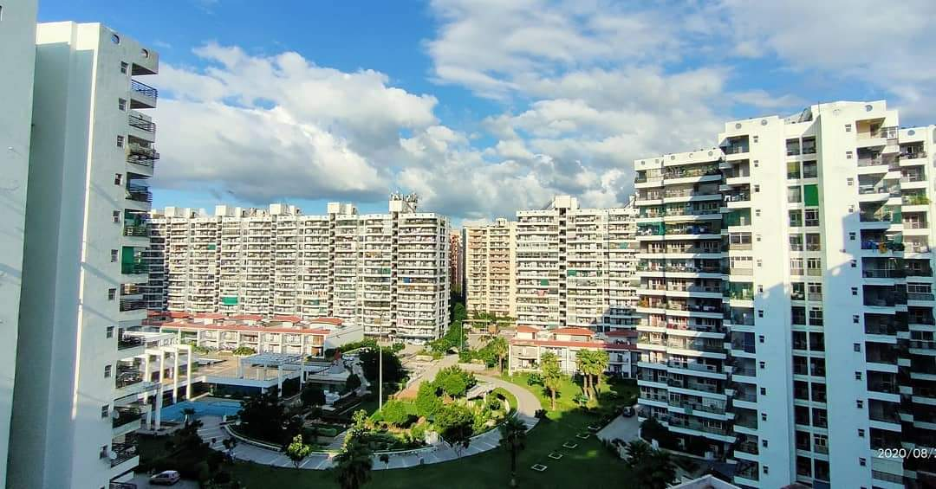
Real Estate (Regulation and Development) Act, 2016 [RERA]
A transformative legislation- enacted in 2016- marked the beginning of a new era in Real Estate Sector
Seeks to regularize & promote Real Estate Sector and protect interest of homebuyers in transparent & accountable manner
Ensures fair transactions, timely delivery & quality construction through speedy adjudication of disputes

Slide 5
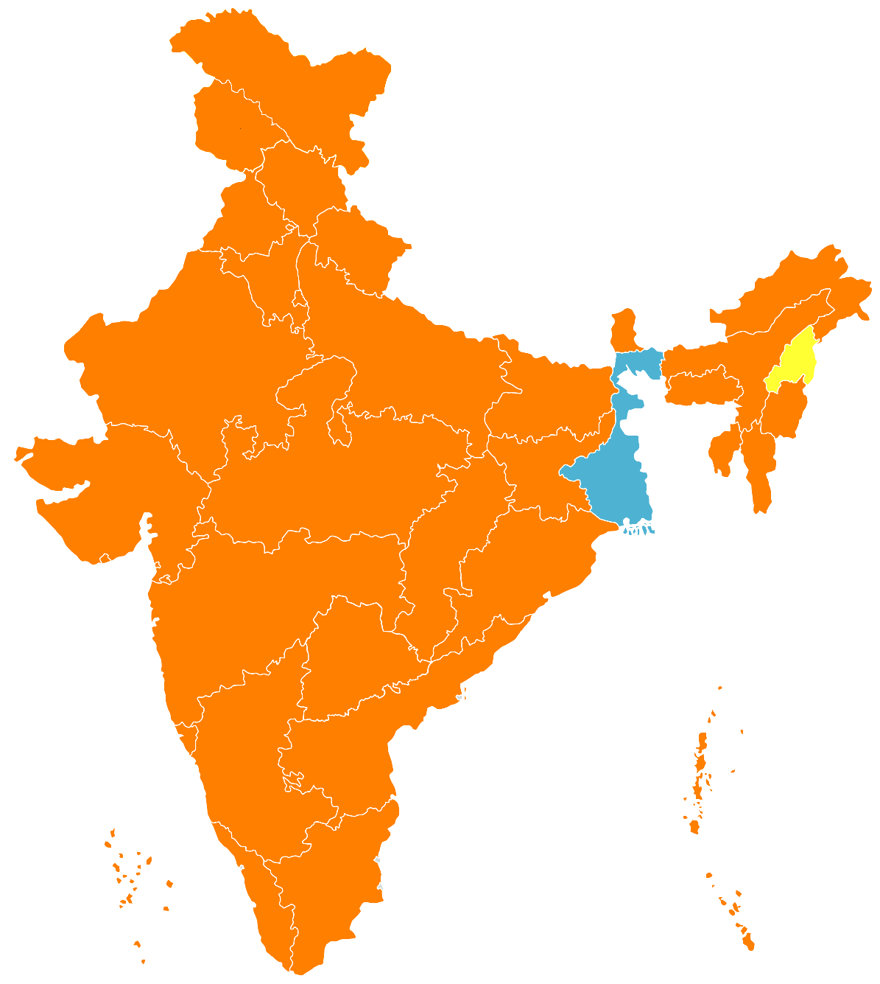
RERA: Implementation Progress
Ladakh
Rules notified under RERA
Jammu & Kashmir
Rules Notification- under progress
Himachal Pradesh
WBHIRA struck down & RERA to be implemented
Rules Notification
34 States/UTs
Projects Registered
67,313
Chandigarh
Punjab
Uttarakhand
Haryana
NCT of Delhi
Arunachal Pradesh
Sikkim
Uttar Pradesh
Assam
Nagaland
Rajasthan
Meghalaya
Regulatory Authorities constituted
30 States/ UTs
Agents Registered
51,895
Bihar
Manipur
Gujarat
Jharkhand
West Bengal
Tripura
Mizoram
Madhya Pradesh
Chhattisgarh
Dadra & Nagar Haveli and Daman Diu
Odisha
Appellate Tribunals formed
28 States/ UTs
Cases Disposed
70,001
Maharashtra
Telangana
Goa
Andhra Pradesh
Karnataka
Andaman & Nicobar Islands
Kerala
Tamil Nadu
Lakshadweep
Puducherry

Slide 6
Tenancy Laws- State Subject
Archaic Tenancy Laws- Paradoxical situation- need for reforms
IMF estimates India’s residential rental market ~ $20 billion (~ ₹ 1.50 lakh crore)
MTA prepared by MoHUA in consultation with States/UTs
Approved by Union Cabinet- 2nd June 2021
Circulated to States/ UTs for adoption
Envisages to balance interests & rights of tenant and landlord in accountable & transparent manner
Aims to create vibrant & sustainable rental housing market and facilitate to unlock vacant houses for rental purpose
Model Tenancy Act

Slide 7
MTA: Key Features
Seeks to cover urban and as well as rural areas
Applicable prospectively & will not affect existing tenancies
Mandates for written agreement for all new tenancies & intimation to Rent Authority
Rent and duration of tenancy to be fixed by mutual consent between owner and tenant through a written agreement
3 Tier adjudicatory mechanism- Rent Authority, Rent Court & Rent Tribunal
Digital platform to be set up for submitting tenancy agreement & other documents
Subletting only with prior consent of landlord
No monetary ceiling- enables parties to negotiate & execute agreement on mutually agreed terms

Slide 8
MTA: Key Features
Security deposit equal to a maximum of 2 month’s rent in case of residential premises and maximum of 6 month’s rent in case of non-residential premises
Roles & responsibilities of landlord & tenant clearly defined- dispute reduction
Landlord / Property Manager not to withhold Essential Supplies/ Services
No eviction of tenant during currency of tenancy period except in accordance with provisions of the Act
Tenant to pay enhanced rent in case of non-vacancy post termination of tenancy: double the monthly rent for first 2 months and 4 times thereafter
No structural change in premises by tenant without written consent of landlord
Time bound & robust grievance redressal mechanism comprising of Rent Authority, Rent Court & Rent Tribunal
Jurisdiction of civil courts barred

Slide 9

MTA: Implementation Progress
Already implemented- Andhra Pradesh, Tamil Nadu & Uttar Pradesh
Draft Rules being prepared – will be circulated soon
Standardized Digital Platform being developed for compliance & effective implementation – will be shared soon

Slide 10
Key Initiatives for Real Estate sector
Infrastructure
Status
NUHF
Reduction of GST
AHF
Infrastructure Status to Affordable Housing
National Urban Housing Fund (NUHF) - EBR of Rs. 60,000 for funding PMAY(U) projects
8% to 1% in Affordable Housing projects (without ITC)
Affordable Housing Fund (AHF) with initial corpus of Rs. 10,000 Cr. to reduce interest burden on affordable housing
12% to 5% in other housing projects (without ITC)
Income Tax Benefits
Extension of benefits of Section 80 IBA & 80 EEA of Income Tax Act extended for one more year, till 31st March 2022
AIF
Alternate Investment Fund (AIF)- SWAMIH fund of INR 25,000 Cr. for last mile funding of stalled housing projects
EoDB
Major jump in ease of doing business rank in Word Bank’s Doing Business Report from 142nd to 63rd. In construction permit, India climbed from 52th to 27th place
Notes:
SWAMIH:
To give relief to homebuyers of stalled projects, a Special Window for Affordable and Mid-Income Housing Fund (SWAMIH) Investment Fund has been established to provide last mile funding for projects that are net-worth positive and registered under RERA, including those projects that have been declared as Non-Performing Assets (NPAs) or are pending proceedings before the National Company Law Tribunal (NCLT) under IBC.
SBICAP Ventures Limited shall be engaged to be the Investment Manager.
As per update received from DEA:
As per industry estimates, in the stalled category, there are about 1509 housing projects comprising of approximately 4.58 lakh housing units.
185 deals aggregating to > ₹ 17,121 Cr approved
benefiting ~ 1,09,478 homebuyers
unlock projects worth ~ ₹ 51,115 Cr

Slide 11


Thanks

